Slide 1
SOLID Objects

Slide 2
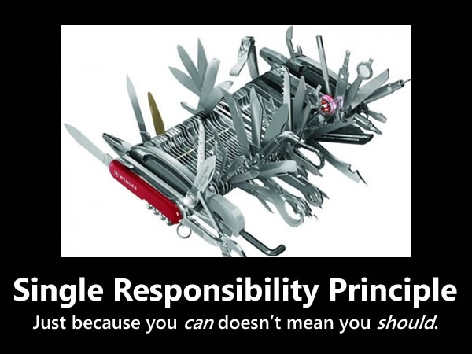
Single Responsibility Principle
Single Responsibility Principle photo by Derick Bailey under CC BY-SA

Slide 3
Single Responsibility Principle
Objects should have cohesive and complete responsibilities.
It shouldn't be aware of knowledge it doesn't need and it shouldn't perform responsibilities that are irrelevant from it.

Slide 4
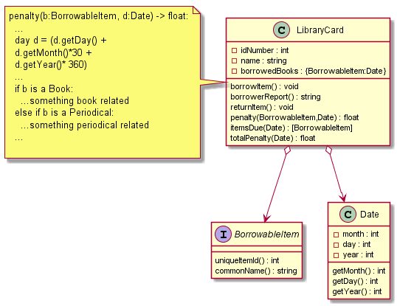
GOD Class (violation)

Slide 5
Assigning the correct responsibilities
When you're introducing new behavior or information to a system, you should ask first: who should be responsible of this behavior or information?
Who should be responsible of calculating the differences between dates? Date should be responsible, not LibraryCard.
Who should be responsible of calculating the penalties of specific BorrowableItem realizations? BorrowableItem realizations should be responsible, not LibraryCard

Slide 6
Open/Close Principle
Classes should be open to extension and closed to modification.
Instead of changing the form and behavior of an existing class, you should extend the class

Slide 7
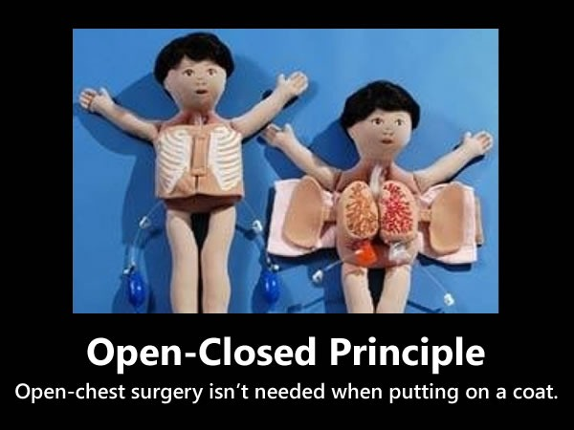
Open/Close Principle
Open-Closed Principle photo by Derick Bailey under CC BY-SA

Slide 8
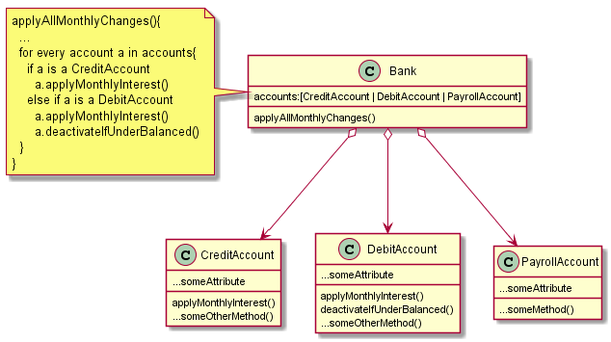
Open for Modification (violation)

Slide 9
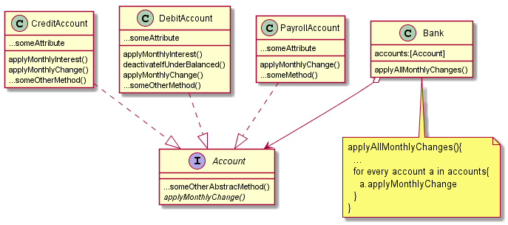
Open for Extension

Slide 10
Liskov- Substitution Principle
Substituting objects by their subtypes/realizations should always work.

Slide 11
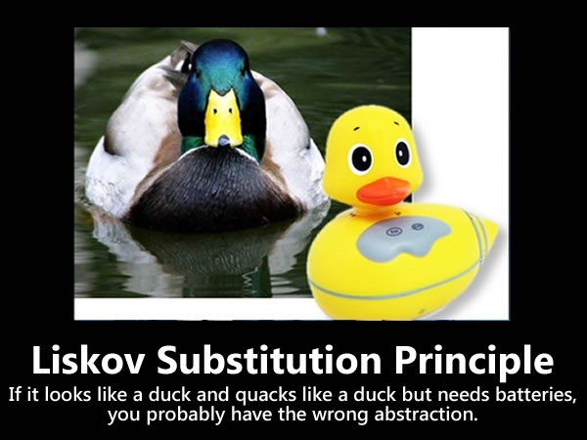
Liskov Substitution Principle
Liskov Substitution Principle photo by Derick Bailey under CC BY-SA

Slide 12
Which relationship is better? Realization or Specialization

Slide 13
Interface Segregation Principle
A client shouldn't be forced to implement methods that it doesn't use.

Slide 14
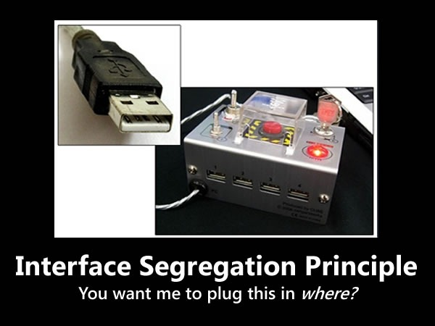
Interface Segregation Principle
Interface Segregation Principle photo by Derick Bailey under CC BY-SA

Slide 15
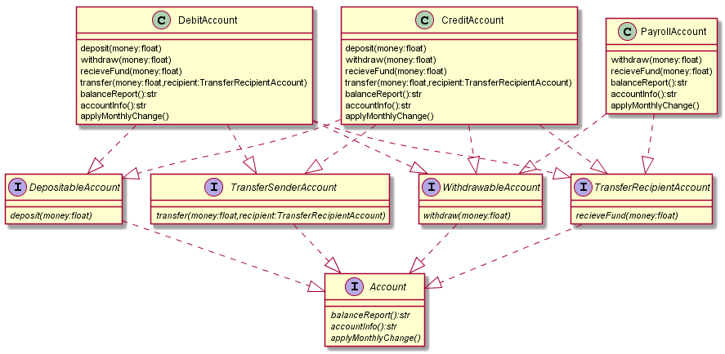
Role Interfaces

Slide 16
Dependency Inversion Principle
Object relationships should depend on abstractions instead of implementations

Slide 17

Dependency Inversion Principle
Dependency Inversion Principle photo by Derick Bailey under CC BY-SA

Slide 18
References
Motivational Pictures Reference
Bailey D. (2009) SOLID Development Principles – In Motivational Pictures. Retrieved from https://lostechies.com/derickbailey/2009/02/11/solid-development-principles-in-motivational-pictures/
SOLID Motivational Posters, by Derick Bailey, is licensed under a Creative Commons Attribution-Share Alike 3.0 United States License.
http://creativecommons.org/licenses/by-sa/3.0/us/

